Slide 1

TrackPack
Keeping your child safe

Slide 2
Peace of Mind
The TrackPack is a piece of safeguarding technology that is handy and convenient to use and is aimed at parents
Mission
Vision
What we are trying to achieve is a simple and straight forward device that can track a child's location for their safety and reassurance of their parents.
Is to combat the amount of children that are abducted every year and ensure safety of minors
Goals
Values
If this product would be on the market, our goal would be to improve the owners safety and ensure their knows where they are at all times.
This device is straight forward and easy to set up and use. By utilizing the long range, low power wireless communication features of the Explorer, making it ideal for this job.

Slide 3
Reported to phone
On the guardian’s side they will be updated every 5 minutes and if the child is diverted from their usual route or is separated from their walking partner, a notification is sent to their phone to then alert them.
Location on map
The Explorer will ping the co-ordinates every 5 minutes mapping the route of the owner. Furthermore you can map out the usual routes you would take for example: Going to school or going to the shops.
Compared with crime stats
First: What is a Fast-Fish? Alive or dead a fish is technically fast, when it is connected with an occupied ship or boat, by any medium at all controllable by the or occupants,—a mast, an oar, a nine-inoccupantch cable, a telegraph wire, or a strand of cobweb, it is all the same.

Slide 4

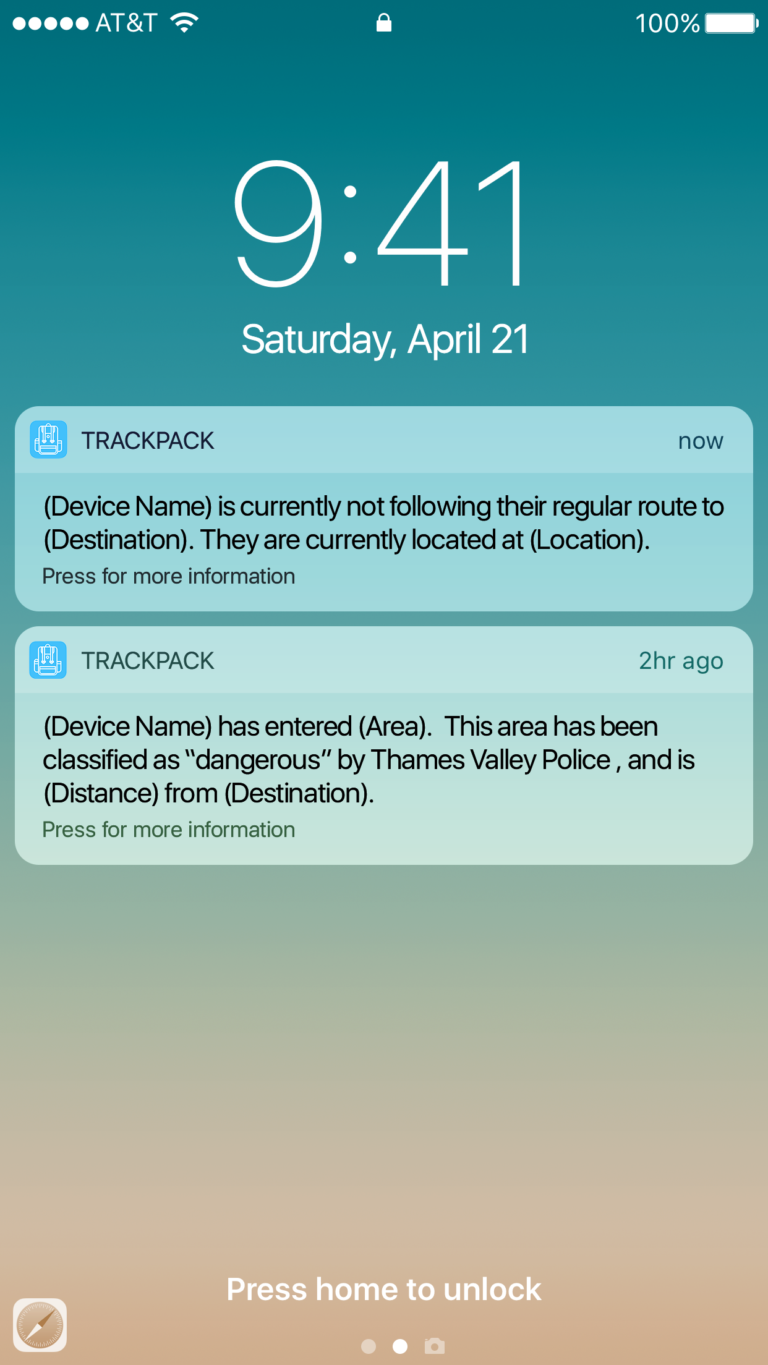
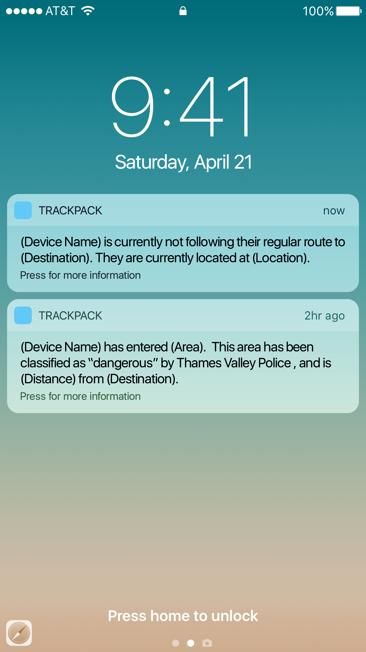
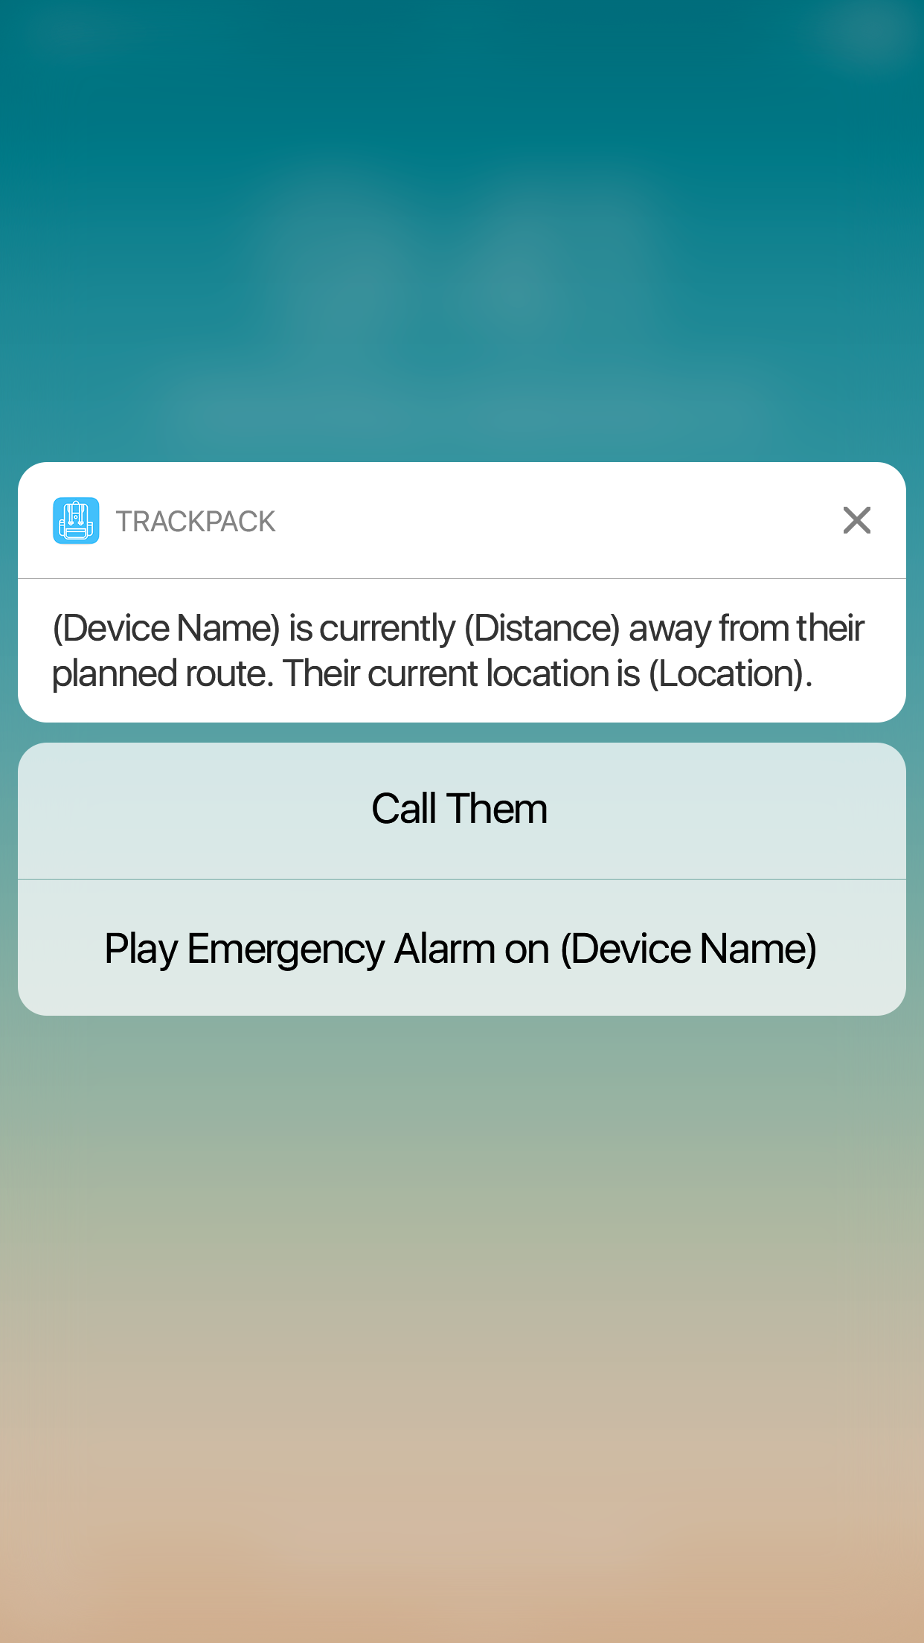
iPhone Mockup Included
Write something in this section
First: What is a Fast-Fish? Alive or dead a fish is technically fast, when it is connected with an occupied ship or boat, by any medium at all controllable by the occupant or occupants,—a mast, an oar, a nine-inch cable, a telegraph wire, or a strand of cobweb, it is all the same. Likewise a fish is technically fast when it bears a waif, or any other recognized symbol of possession; so long as the
First: What is a Fast-Fish? Alive or dead a fish is technically fast, when it is connected with an occupied ship or boat
First: What is a Fast-Fish? Alive or dead a fish is technically fast, when it is connected with an occupied ship or boat
First: What is a Fast-Fish? Alive or dead a fish is technically fast, when it is connected with an occupied ship or boat

